Slide 1


Truist Foundations & Endowments Specialty Practice 2Q2024 Review and Outlook
© 2020 Truist Financial Corporation. Truist, Truist purple, and the Truist logo are service marks of Truist Financial Corporation.

Slide 2
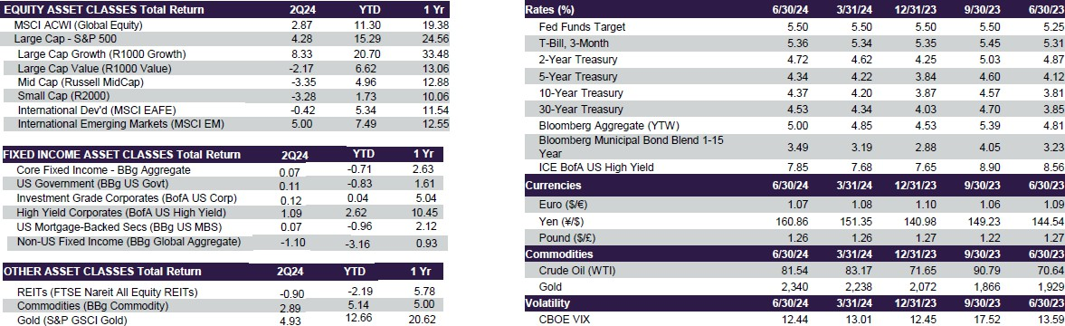
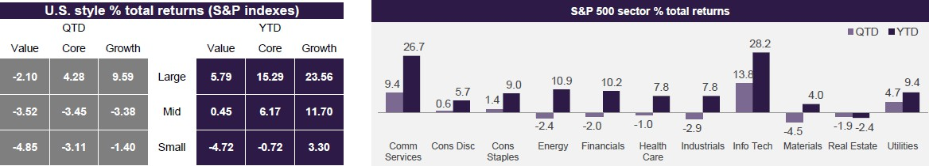
Performance Summary as of June 30, 2024
Foundation and Endowments Specialty Practice
Disclosures – All information is as of title date unless otherwise noted. You cannot invest directly in an index. This document was prepared for clients of Truist Bank for informational purposes only. This material may not be suitable for all investors and may not be redistributed in whole or part. Neither Truist Financial Corporation, nor any affiliates make any representation or warranties as to the accuracy or merit of this analysis for individual use. Information contained herein has been obtained from sources believed to be reliable but are not guaranteed. Comments and general statistics are based on information available at the time of writing and believed to be accurate; are for informational purposes only, are not intended as individual or specific advice, may not represent the opinions of the entire firm and may not be relied upon for future investing. The views expressed may change at any time. The information provided in this report should not be considered a recommendation to purchase or sell any financial instrument, product or service sponsored or provided by Truist Financial Corporation or its affiliates or agents. Investors are advised to consult with their investment professional about their specific financial needs and goals before making any investment decisions. Past returns are not indicative of future results. An investment cannot be made into an index. ©2020 Truist Financial Corporation. and Truist are service marks of Truist Financial Corporation. All rights reserved.
Sources: Truist IAG, FactSet

Slide 3
Resilient economy and market-momentum frame our outlook
Foundation and Endowments Specialty Practice
Upside catalysts
Easing in economic and inflation trends should allow the Federal Reserve to cut rates this year
U.S. forward earnings estimates continue to make record highs
The stock market has typically risen in the 6-to-12 months following the first rate cut
During election years, there’s incentive for the party in power to stimulate the economy, historically resulting in solid, albeit bumpy, market gains
Primary upward trend appears intact, aided by forward earnings estimates
Downside risks
Federal Reserve may not cut rates as quickly as market anticipates Earnings assumptions could be too optimistic
Market valuations are expensive Market leadership has narrowed
Election year uncertainty and broader geopolitical risks
Sources: Truist IAG, Strategas

Slide 4

Word of the day: inflection
Recent equity rotation – more economic driven than election driven
Small cap rally – more upside near term but earnings key to sustainable shift
Technology – important short-term juncture with big cap earnings next 2 weeks
EM – China rolling over again: Stay negative EM

Slide 5
Catalyst for sharp rotation primarily softer CPI report, less “Trump trade”
YTD % returns before & after July 11 CPI report
35.9
YTD through CPI
Returns post-CPI
18.1
8.2
1.2
-1.2
-5.1
Tech sector
S&P 500
S&P small
Data source: Truist IAG, Past performance does not guarantee future results.

Slide 6

Small cap bouncing back from extreme underperformance
Small cap % returns relative to S&P 500 6-month rolling
50%
40%
30%
20%
10%
0%
-10%
-20%
-30%
-40%
'94 '95 '96 '97 '98 '99 '00 '01 '02 '03 '04 '05 '06 '07 '08 '09 '10 '11 '12 '13 '14 '15 '16 '17 '18 '19 '20 '21 '22 '23 '24
Data source: Truist IAG, Past performance does not guarantee future results.

Slide 7
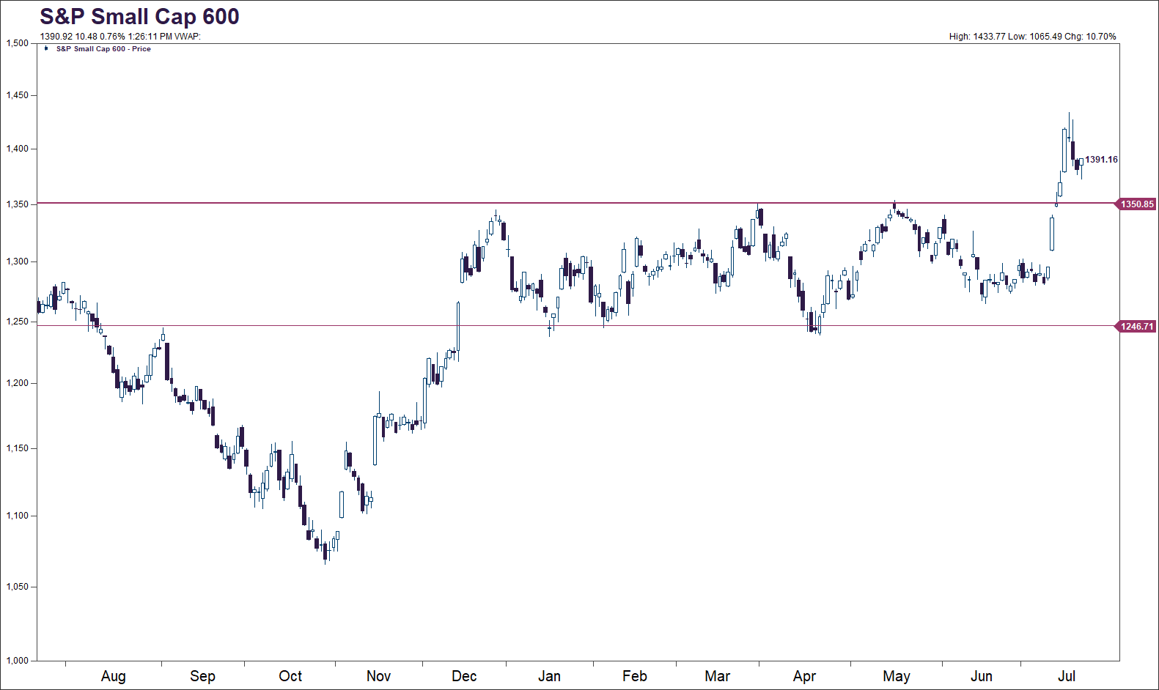
Small cap upside break of range
Data source: Truist IAG, Morningstar. Past performance does not guarantee future results.

Slide 8
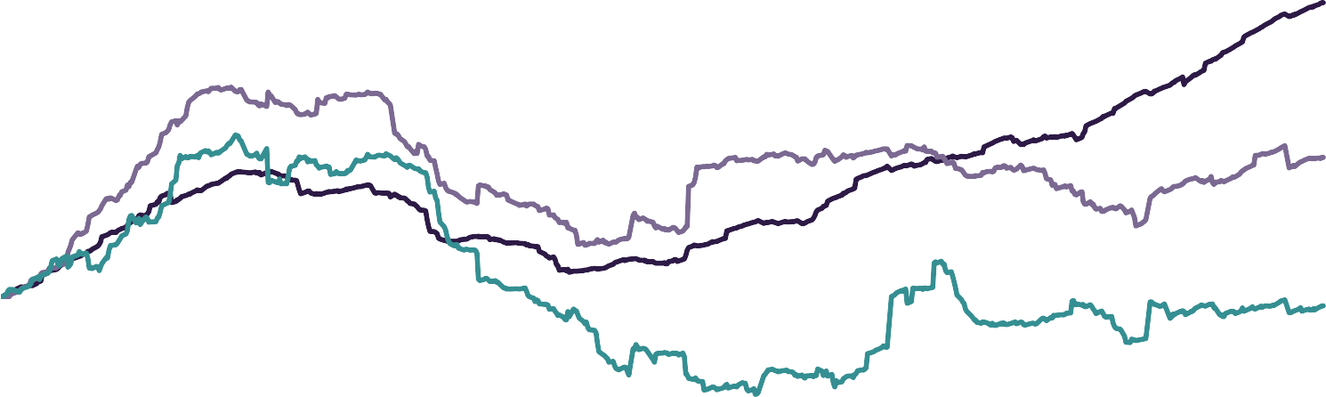
Small caps - earnings improvement key for a rally beyond short term
Forward earnings per share
S&P Mid Cap 400 S&P Small Cap 600
S&P 500
120
115
110
105
100
95
90
Dec-21
Jun-22
Nov-22
Apr-23
Sep-23
Feb-24
Jul-24
Data source: Truist IAG, FactSet. Past performance does not guarantee future results.

Slide 9

Technology sector pulling back following extreme short-term outperformance, though fundamentals still solid
Tech sector relative to S&P 500 Rolling 2-month performance
Technology price & earnings trends relative to S&P 500
Tech relative price (left) Tech relative earnings (right)
20%
140
120
15%
15.4%
130
115
10%
5.7%
120
110
5%
0%
105
110
-5%
100
100
95
-10%
-15%
90
90
'04 '06 '08 '10 '12 '14 '16 '18 '20 '22 '24
80
85
2022
2022
2023
2024
Data source: Truist IAG, FactSet. Past performance does not guarantee future results.

Slide 10
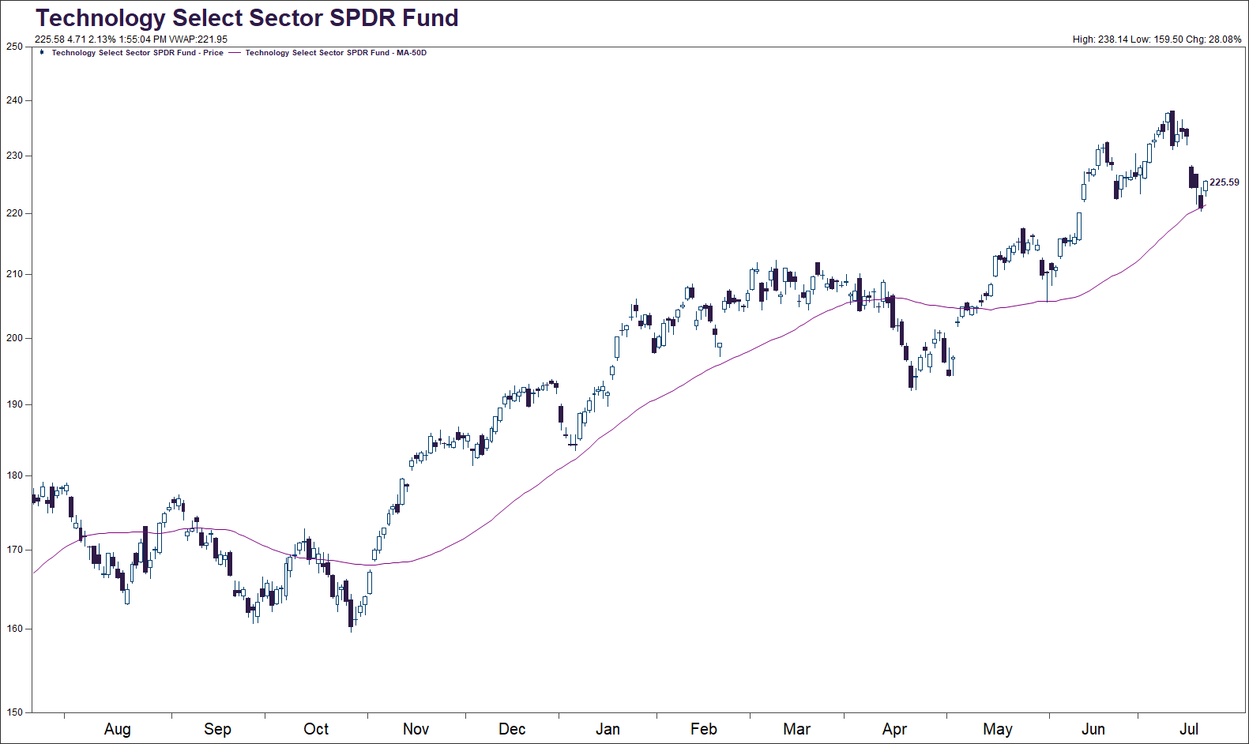
Technology pullback in perspective – important short-term juncture
EPS reports: This week Next week Alphabet Apple
Tesla Microsoft Amazon Meta
Data source: Truist IAG. Past performance does not guarantee future results.

Slide 11
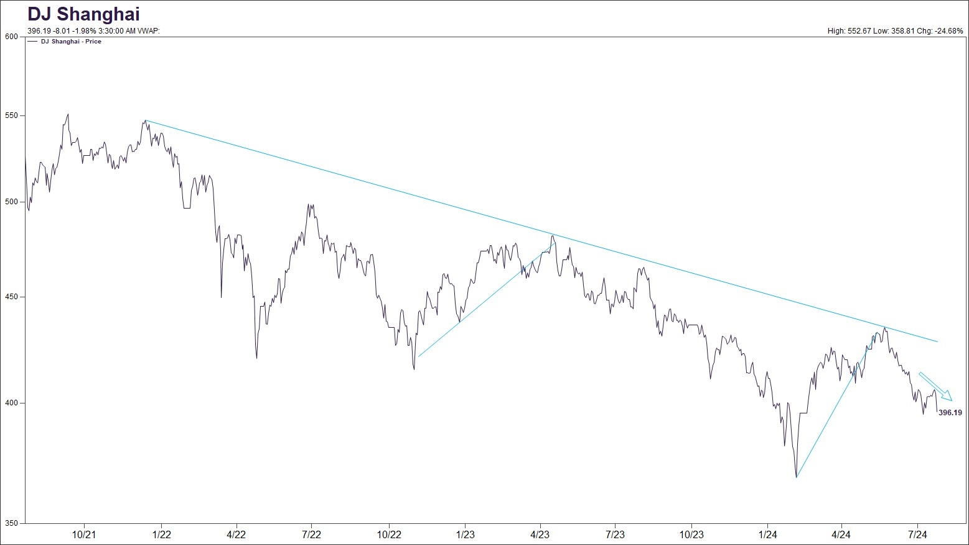
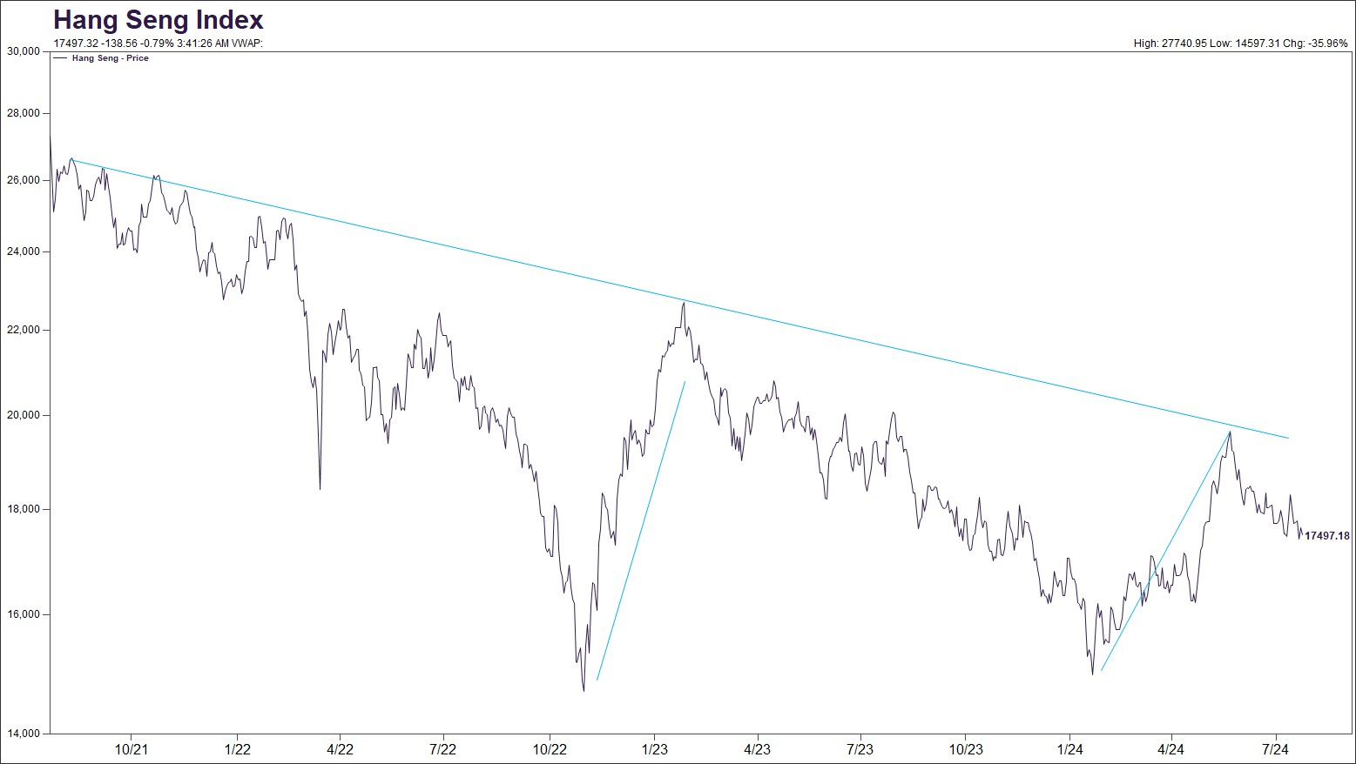
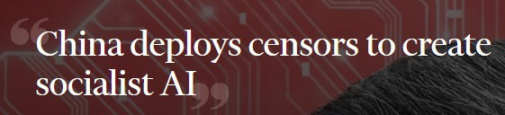
China rolling over again as third plenum disappoints – stay negative EM
China's third plenum - Emphasized need to strengthen domestic security, surveillance, censorship, and “public opinion guidance
Data source: Truist IAG. Past performance does not guarantee future results. BCA, FT

Slide 12
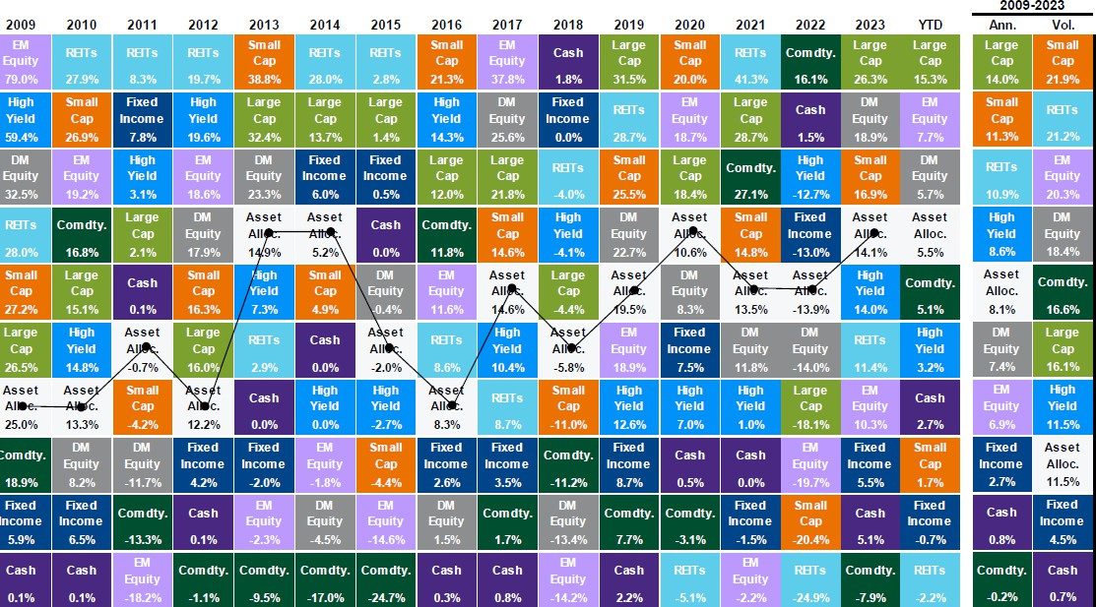
Asset Class Returns – The importance of strategic & tactical allocations
Foundation and Endowments Specialty Practice
Source: J.P. Morgan, Bloomberg, FactSet, MSCI, NAREIT, Russell, Standard & Poor’s, J.P. Morgan Asset Management.
Large cap: S&P 500, Small cap: Russell 2000, EM Equity: MSCI EME, DM Equity: MSCI EAFE, Comdty: Bloomberg Commodity Index, High Yield: Bloomberg Global HY Index, Fixed Income: Bloomberg US Aggregate, REITs: NAREIT Equity REIT Index, Cash: Bloomberg 1-3m Treasury. The “Asset Allocation” portfolio assumes the following weights: 25% in the S&P 500, 10% in the Russell 2000, 15% in the MSCI EAFE, 5% in the MSCI EME, 25% in the Bloomberg US Aggregate, 5% in the Bloomberg 1-3m Treasury, 5% in the Bloomberg Global High Yield Index, 5% in the Bloomberg Commodity Index and 5% in the NAREIT Equity REIT Index. Balanced portfolio assumes annual rebalancing. Annualized (Ann.) return and volatility (Vol.) represents period from 12/31/2008 to 12/31/2023. Please see disclosure page at end for index definitions. All data represents total return for stated period. The “Asset Allocation” portfolio is for illustrative purposes only. Past performance is not indicative of future returns. U.S. Data are as of June 30, 2024.

Slide 13
ECONOMY / FEDERAL RESERVE
Foundation and Endowments Specialty Practice
Global economic outlook is improved but still expect below-trend growth this year
Consumer benefiting from still-healthy, albeit cooling, labor market and real wage gains, though rising interest rates on debt starting to impact
Federal Reserve rate cuts dependent on greater confidence that inflation is sustainably moving toward 2%

Slide 14
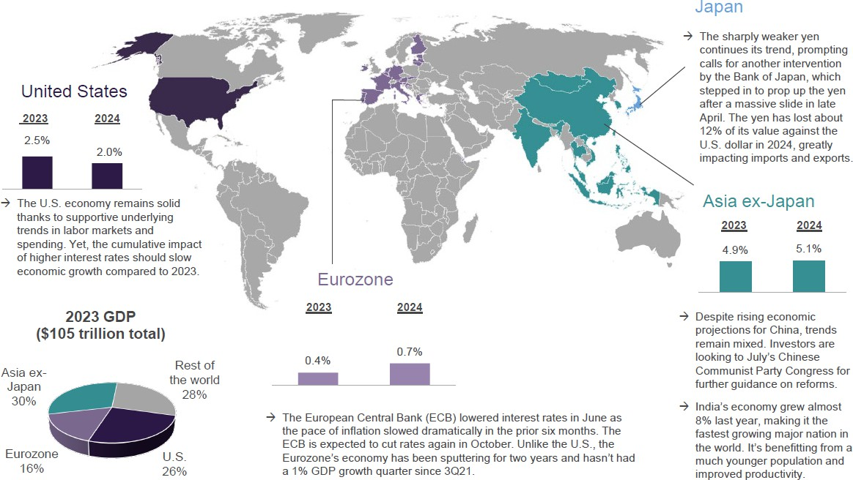
Global growth outlook: resilient but below-trend
Foundation and Endowments Specialty Practice
Sources: Truist IAG, Bloomberg. Real GDP for 2023 are actual results. 2024 U.S. GDP estimate =Truist IAG; regional GDP estimates from Bloomberg

Slide 15
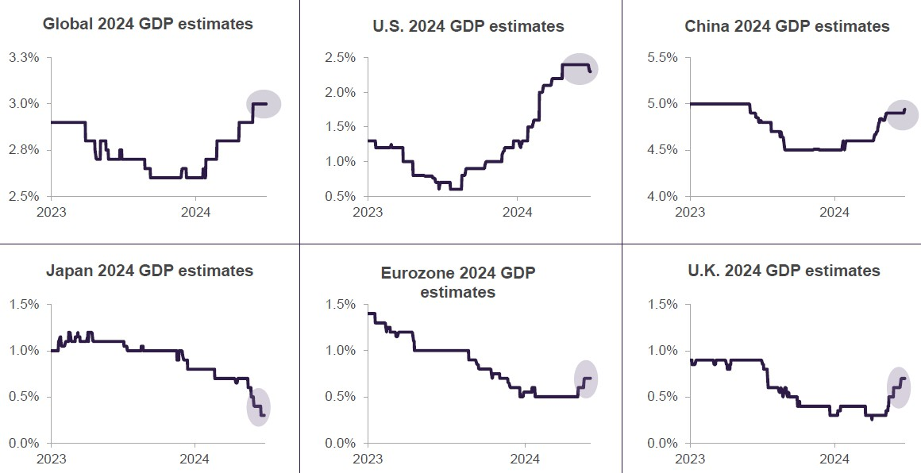
Global 2024 GDP trends show modest improvement, U.S. momentum eases
Foundation and Endowments Specialty Practice
Sources: Truist IAG, Bloomberg. Change in real (inflation-adjusted) gross domestic product (GDP) year-over-year; consensus estimates through 6.26.24

Slide 16
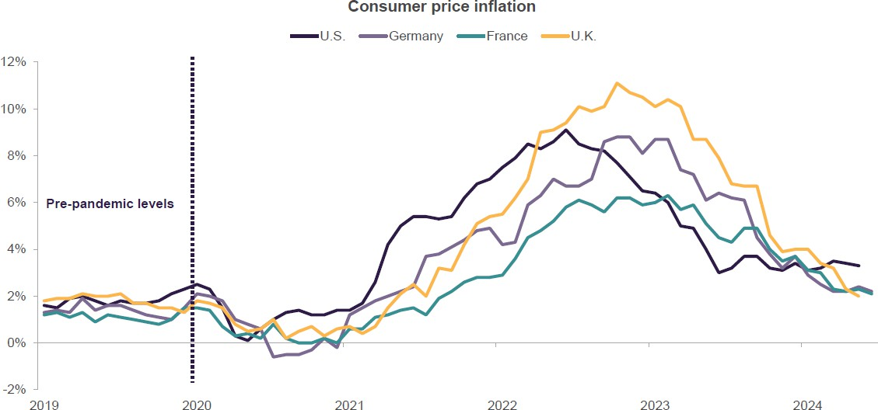
Global inflation has declined sharply though still above pre-pandemic levels
Foundation and Endowments Specialty Practice
Sources: Truist IAG, Bloomberg. Data through June 2024 expect for U.S. and U.K.

Slide 17
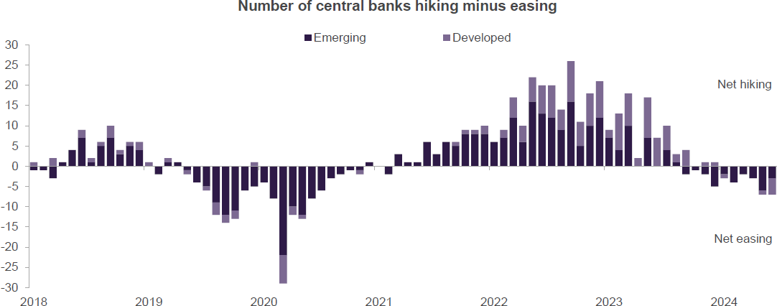
Major central banks have begun cutting rates for the first time in years
Foundation and Endowments Specialty Practice
OUR TAKE: Some developed-markets central banks, including the ECB and Bank of Canada, lowered rates in June for the first time in years, finally joining the easing band wagon started by EM central banks last fall. U.S. Federal Reserve and Bank of England expected to follow suit later this year
Sources: Truist IAG, Haver. Series constructed using predominantly countries in MSCI All Country World Index

Slide 18
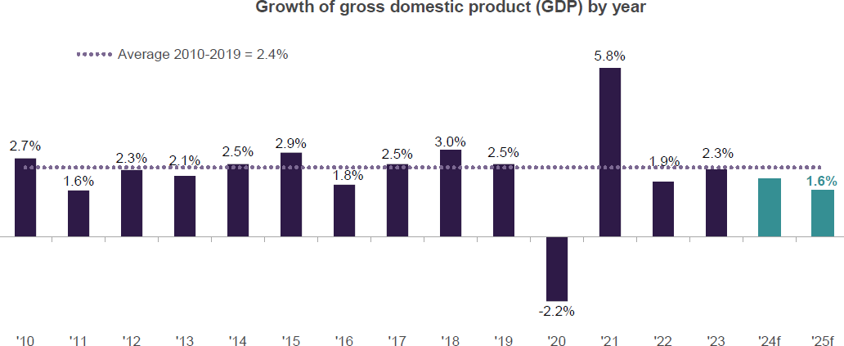
U.S. outlook: We expect modestly slower growth than 2023
Foundation and Endowments Specialty Practice
OUR TAKE: We expect 2024 GDP growth of 2.0% as the U.S. economy remains resilient as evidenced by solid consumer spending and continued hiring. However, the cumulative impact of higher rates should weigh on growth as compared to 2023.
Sources: Truist IAG, Bureau of Economic Analysis, IHS Markit. Change in real gross domestic product year over year; actual through 1Q2024, Truist IAG forecast for 2024 and 2025

Slide 19
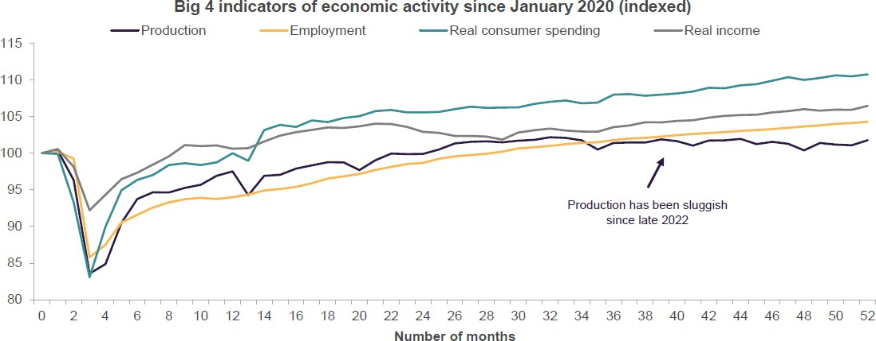
Big 4 indicators point toward continued growth for U.S. economy
Foundation and Endowments Specialty Practice
OUR TAKE: Four of the primary indicators followed by the National Bureau of Economic Research (NBER) Business Cycle Dating Committee, which are coincidental rather than leading, suggest the U.S. is not in recession territory
Sources: Truist IAG, Bloomberg. Monthly data through May 2024 for industrial production, number of nonfarm payrolls, real (inflation-adjusted) personal consumption expenditures (chained 2017 dollars), and real (inflation-adjusted) personal income excluding transfer receipts (chained 2017 dollars); indexed to January 2020.

Slide 20
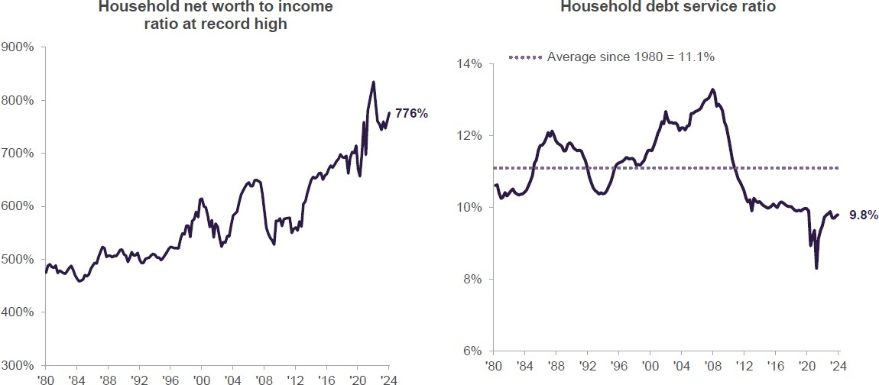
The consumer – over 2/3^{rds} of the U.S. economy – still in generally good shape
Foundation and Endowments Specialty Practice
OUR TAKE: Delinquencies have begun to normalize after being depressed during the pandemic period, yet nearly 97% of consumers remain current on their payments.
Sources: Truist IAG, Bloomberg, Federal Reserve Board. Household net worth as percentage of disposable personal income; quarterly data through first quarter 2024. Debt service payments as percentage of disposable personal income; quarterly data through fourth quarter 2023.

Slide 21
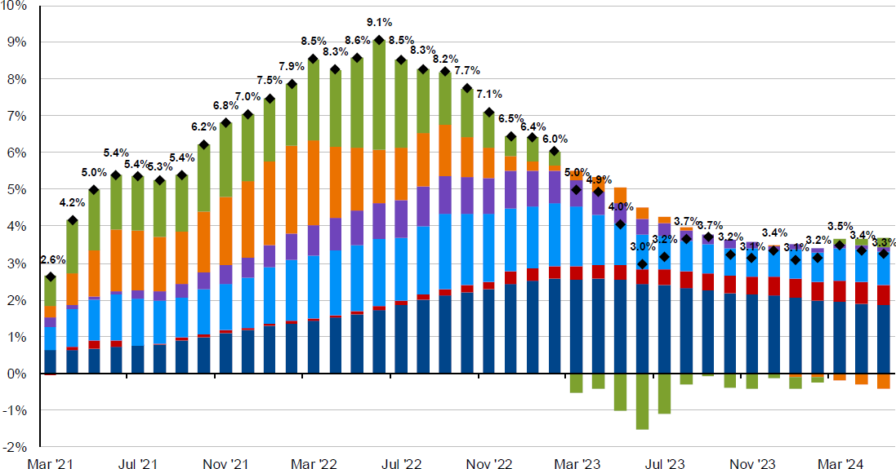
Stickier inflation coming from Services sector
Foundation and Endowments Specialty Practice
OUR TAKE: Service sector inflation, particularly from leisure, auto insurance, and shelter, is contributing to stickier CPI
Contributions to headline CPI inflation
Contribution to YoY% Change in CPI through May 2024
Sources: Truist IAG, Bureau of Labor Statistics, FactSet, J.P. Morgan. “Shelter” includes owners’ equivalent rent, rent of primary residence, and home insurance.

Slide 22
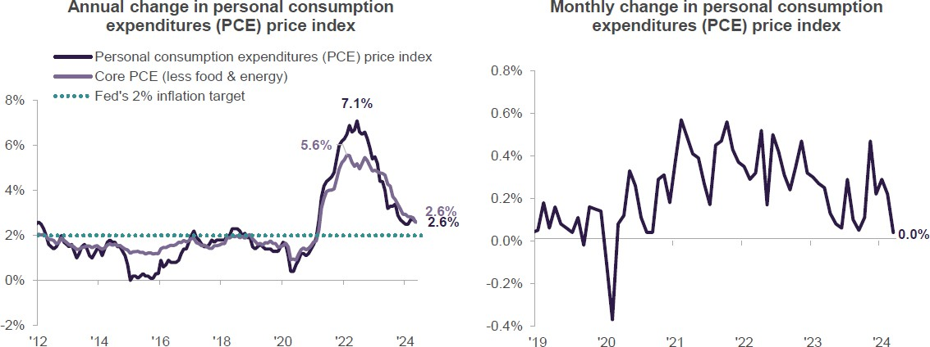
Foundation and Endowments Specialty Practice
OUR TAKE: The PCE Deflator, the Fed’s preferred inflation gauge, was flat in May, the coolest reading in six months. The PCE Deflator, at 2.6%, is precisely at the Fed’s projections for 2024, marking its lowest reading since 2021 and substantially below its 7.1% peak in March 2022.
Sources: Truist IAG, Bloomberg, Bureau of Economic Analysis, monthly data through May 2024

Slide 23
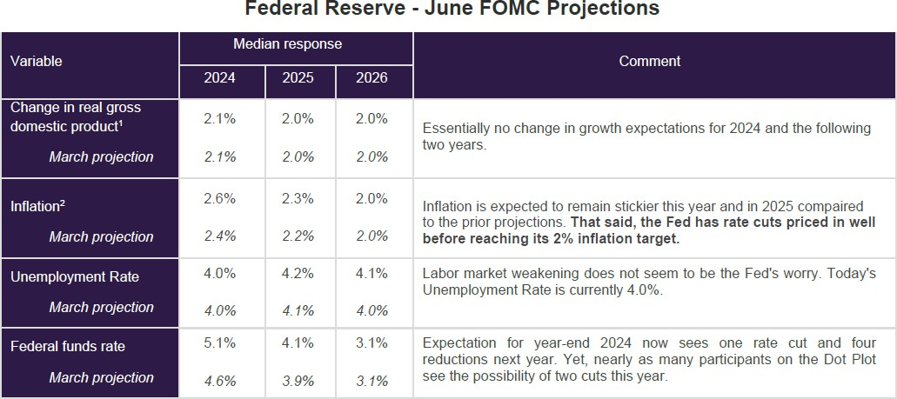
Fed acknowledges stickier inflation, projects fewer cuts in 2024
Foundation and Endowments Specialty Practice
OUR TAKE: In its updated projections in June, the Fed acknowledged the likelihood of stickier inflation in 2024, and reduced its rate-cut projections to one in 2024 rather than previous forecasts of three
Sources: Truist IAG, Bloomberg, Federal Reserve. (1) Percent change from 4Q of previous year to 4Q of year indicated. (2) PCE Deflator [the Fed’s targeted inflation measure]

Slide 24
EQUITY MARKETS
Foundation and Endowments Specialty Practice
Strong YTD S&P 500 achieved largely driven by Top 10 companies
Forward earnings estimates providing tailwind for equity market performance
Maintaining our focus on U.S. large cap due to uncertainty from soft landing challenges and an election year

Slide 25
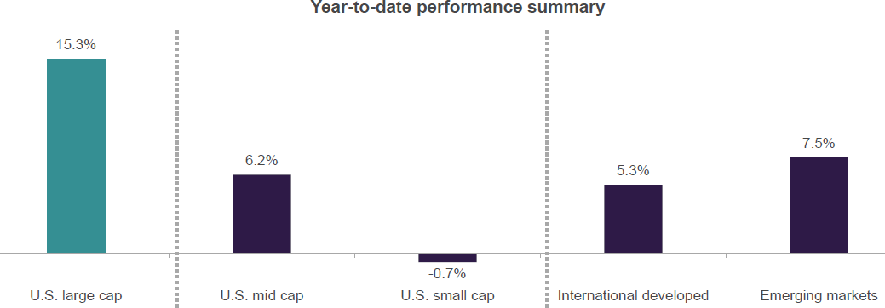
Foundation and Endowments Specialty Practice
OUR TAKE: Our preferences within equities have generally been a positive with our overweight to large cap U.S. relative to small and mid caps and international markets.
Sources: Truist IAG, FactSet. Data as of 6.30.24. Past performance does not guarantee future results. U.S. large caps = S&P 500, U.S. mid cap = S&P Mic Cap 400, U.S. small cap = S&P Small Cap 600, International developed = MSCI EAFE, Emerging markets = MSCI EM.

Slide 26
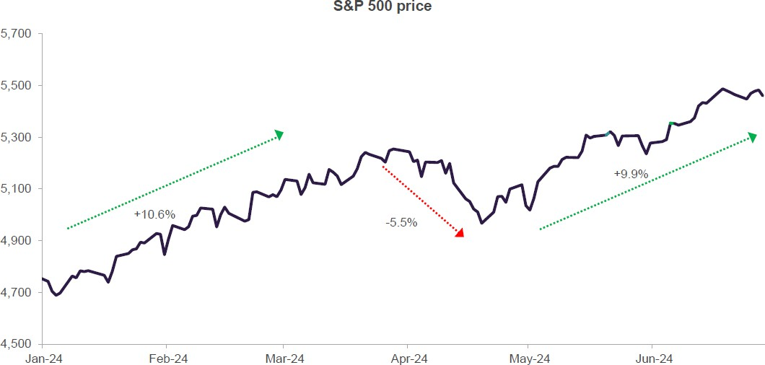
S&P 500 rebounded strongly following first 5% pullback of the year
Foundation and Endowments Specialty Practice
OUR TAKE: Historically, once stocks make a record high after not doing so for at least a year, this tends to have bullish implications. This year’s strong price action, as well as a 5% pullback is consistent with this.
Sources: Truist IAG, FactSet. Past performance does not guarantee future results.

Slide 27
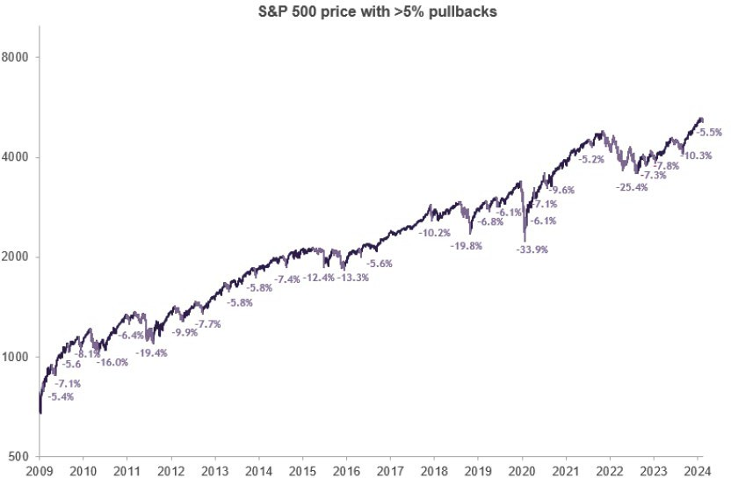
Pullbacks > 5% are typically the norm
Foundation and Endowments Specialty Practice
OUR TAKE: Since March 2009 – where stocks bottomed after the GFC*, there have been 28 pullbacks of at least 5% for the S&P
500. Despite these pullbacks, stocks are up 886% on a total return basis over that entire period.
The recent pullback of
-5.5% was not abnormal
Sources: Truist IAG, Morningstar, Bloomberg. *Global Financial Crisis. Past performance does not guarantee future results

Slide 28
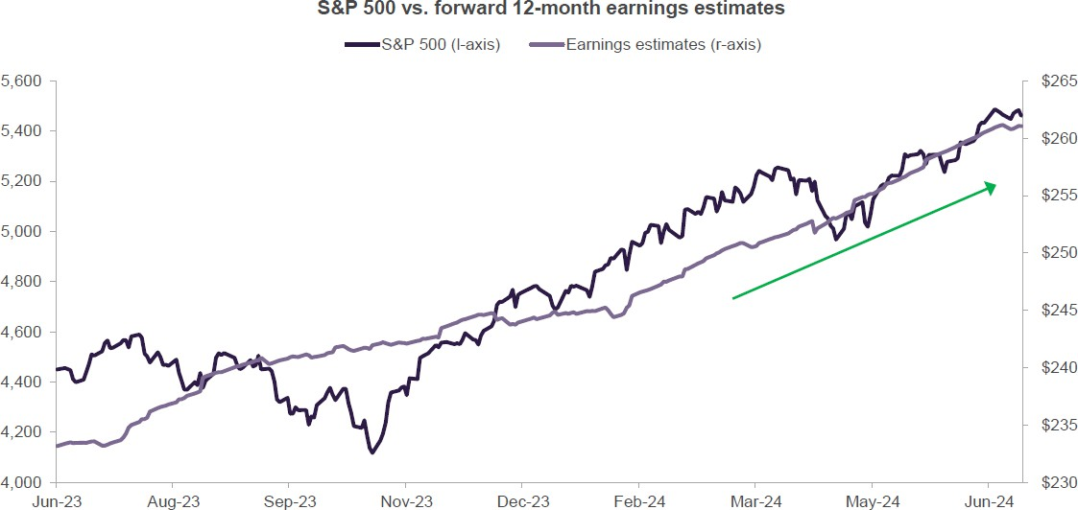
Forward earnings estimates at a record, supporting stocks
Foundation and Endowments Specialty Practice
Sources: Truist IAG, FactSet. Past performance does not guarantee future results.

Slide 29
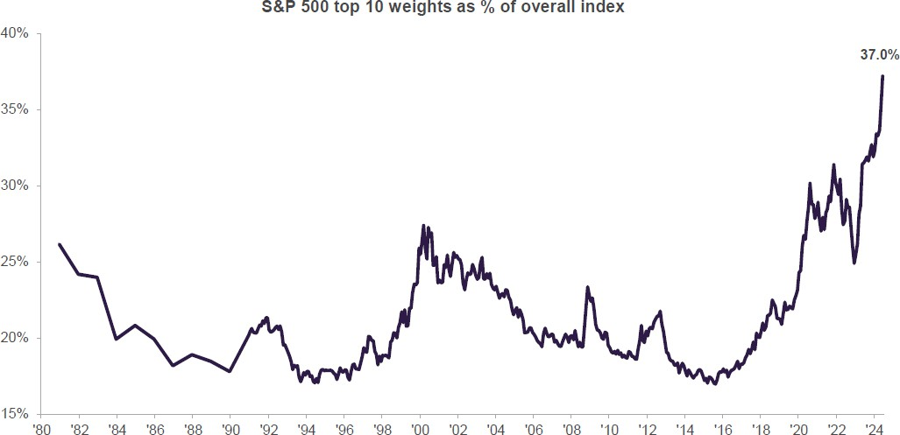
Concentration risks within S&P 500 at record high level
Foundation and Endowments Specialty Practice
OUR TAKE: The 10 largest stocks in S&P 500 have accounted for majority of market returns since 2023; concentration risk is at an historical high
Mag 7
29.8%
Sources: Truist IAG, Strategas, FactSet, J.P. Morgan. Past performance does not guarantee future results. Top 10 S&P 500 companies based on the 10 largest index constituents at the beginning of each month. As of 6/30/24, the Top 10 co’s were: MSFT (7.0%), AAPL (6.3%), NVDA (6.1%), AMZN (3.6%), META (2.3%), GOOGL (2.3%), GOOG (0.9%), BRK.B (1.7%), LLY
(1.5%), JPM 1.3%), AVGO (1.3%)

Slide 30
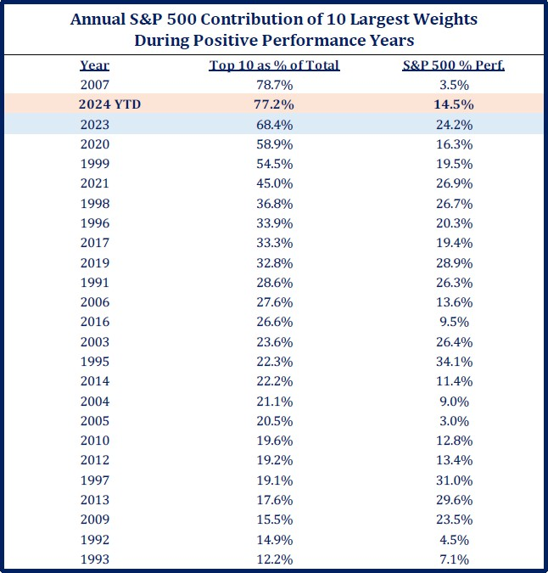
The impact of the Ten largest stocks on the S&P 500’s return
Foundation and Endowments Specialty Practice
OUR TAKE: The 10 largest stocks in S&P 500 have accounted for a large majority of market returns in 2023 and into 2024
Sources: Truist IAG, Strategas. Past performance does not guarantee future results. Top 10 S&P 500 companies based on the 10 largest index constituents at the beginning of each month. As of 6/30/24, the Top 10 co’s were: MSFT (7.0%), AAPL (6.3%), NVDA (6.1%), AMZN (3.6%), META (2.3%), GOOGL (2.3%), GOOG (0.9%), BRK.B (1.7%), LLY (1.5%), JPM 1.3%), AVGO (1.3%)

Slide 31
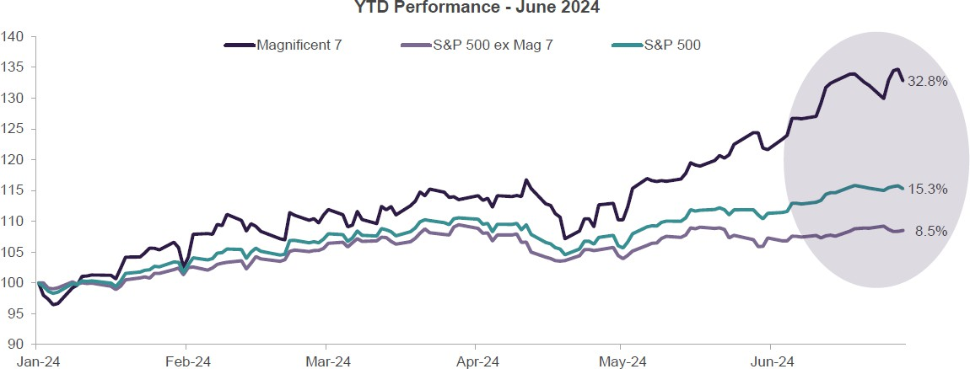
Foundation and Endowments Specialty Practice
OUR TAKE: Mag 7 stocks’ performance has accounted for 61% of the S&P 500’s YTD gain, very similar to its 63% share of 2023’s gain
Sources: Truist IAG, Morningstar, Standard & Poor’s, J.P. Morgan. Magnificent 7 = Apple, Microsoft, Amazon, NVIDIA, Alphabet (combined share classes), Tesla, and Meta

Slide 32
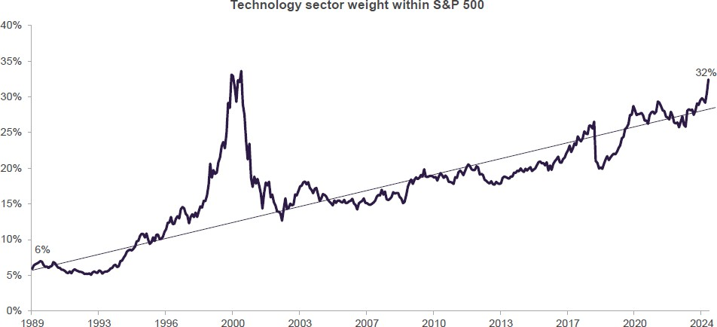
Tech sector comprises outsized 32% of S&P 500
Foundation and Endowments Specialty Practice
OUR TAKE: Tech sector’s influence on the S&P 500 is driving overall market valuations higher as it tends to trade at a premium
Sources: Truist IAG, FactSet. Past performance does not guarantee future results.

Slide 33
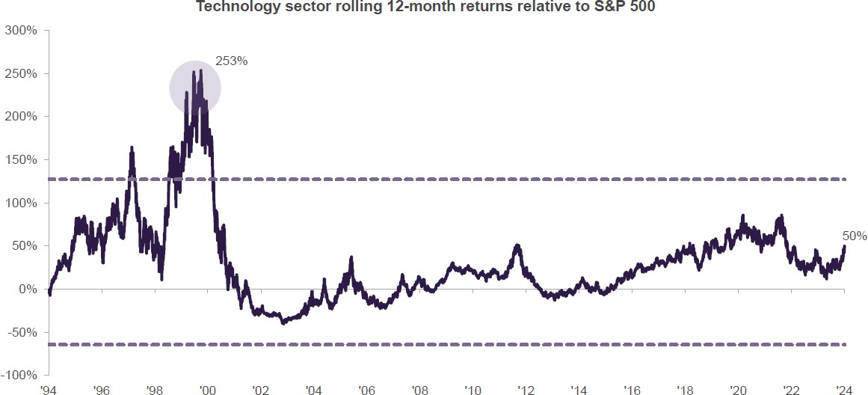
On a comparative basis, Tech seems far from bubble territory
Foundation and Endowments Specialty Practice
Sources: Truist IAG, FactSet. Technology is represented by S&P 500 Information Technology sector. Past performance does not guarantee future results

Slide 34
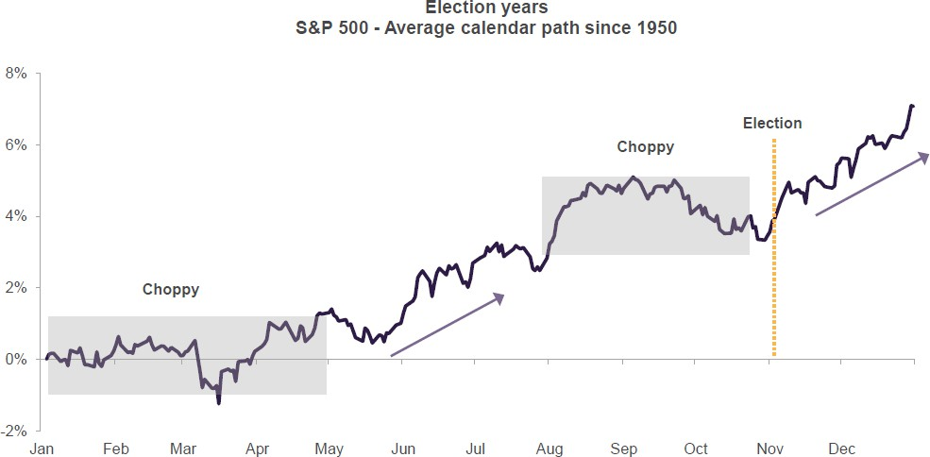
Election years tend to see choppiness in the market
Foundation and Endowments Specialty Practice
Sources: Truist IAG, FactSet. Past performance does not guarantee future results.

Slide 35
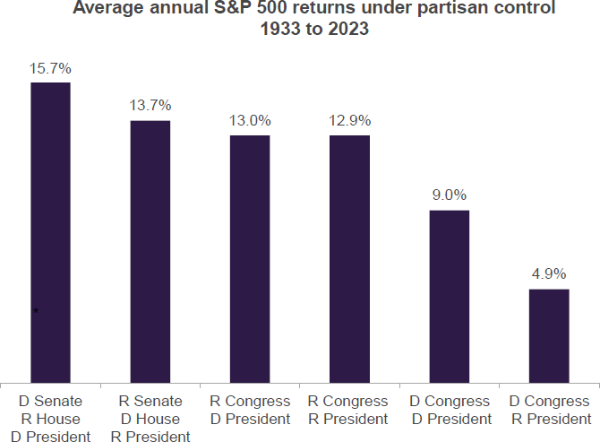
Market has done fine under a wide range of partisan control
Foundation and Endowments Specialty Practice
OUR TAKE: Factors outside of Washington tend to have greater market impact. For this year, the ability of the Federal Reserve to engineer a soft landing and the path of inflation will have a greater impact on the market than the results of the 2024 election.
Sources: Truist IAG, FactSet. Strategas. Past performance does not guarantee future results.

Slide 36
FIXED INCOME MARKETS
Foundation and Endowments Specialty Practice
Treasury yields have likely peaked this cycle, but upside inflation surprises and increased debt issuance provide headwinds
The move to higher yields leaves high quality fixed income capable of providing critical income and portfolio ballast
Bond yields typically fall after first Fed rate cut, though heavy Treasury issuance could impede the 10-year yield’s decline

Slide 37
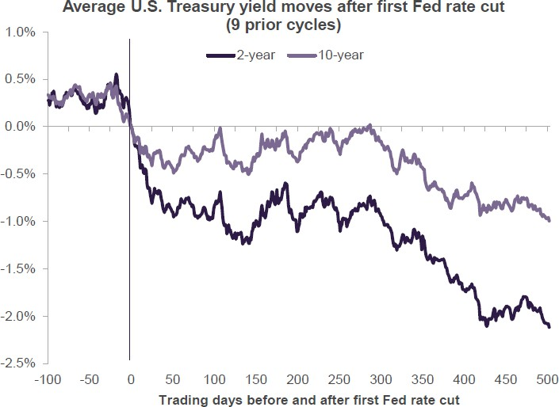
Yields tend to fall, curve typically steepens after first Fed rate cut
Foundation and Endowments Specialty Practice
OUR TAKE: Treasury yields typically decline in the months following the start of a Fed rate cut cycle
Add comment about business cycle (previous cuts due to recession, only 1994
= soft landing; Fed cutting now because of INFLATION; late 60’s not reflected in this chart; 10’s might not fall (goes up in soft landing)
Sources: Truist IAG, Bloomberg. Past performance does not guarantee future results.

Slide 38
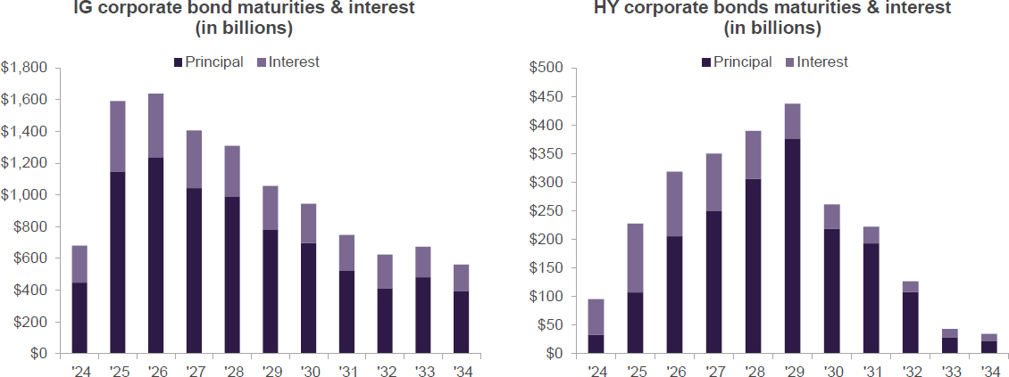
U.S. companies face $7 trln in debt maturities over next 5 years
Foundation and Endowments Specialty Practice
OUR TAKE: Investment grade and high yield companies face a wave of maturities over the next five years. Near-term maturities will likely need to be refinanced at higher costs to the issuers and place additional pressure on corporate balance sheets.
Sources: Truist IAG, Bloomberg. IG = All USD investment grade rated corporate bonds, HY = all USD high yield rated corporate bonds. Past performance does not guarantee future results.

Slide 39
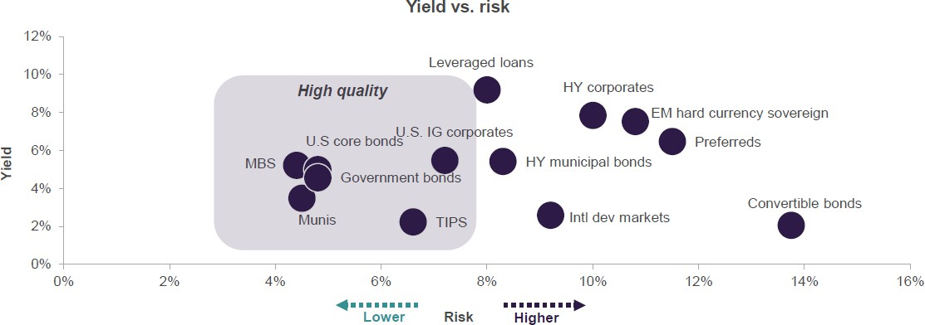
Maintain focus on high quality in fixed income and tactical active managers
Foundation and Endowments Specialty Practice
OUR TAKE: We continue to favor high quality fixed income – an important source of portfolio ballast. Additionally, higher yields in higher-risk fixed income sectors bode well for careful tactical active management to supplement core fixed income.
Sources: Truist IAG, Bloomberg, FactSet, LSTA. Yield to worst shown except Preferreds (yield to maturity). Past performance does not guarantee future results.
Sources: Truist IAG, Bloomberg. Change in real (inflation-adjusted) gross domestic product (GDP) year-over-year; consensus estimates through 6.26.24

Slide 40
Important Disclosures
Foundation and Endowments Specialty Practice
Truist Foundations and Endowments Specialty Practice
Banking and trust products and services are provided by Truist Bank, F/K/A SunTrust Bank or BB&T (“Truist Bank”). Truist Bank may use or offer the services of affiliate companies as well as third party entities to achieve your banking and investment objectives. Where applicable, any affiliations and all pertinent provider information will be disclosed in accompanying agreements and prospectuses.
Truist Bank, its affiliates, officers, agents, and employees are not authorized to give legal, tax or accounting advice. Only an attorney can draft legal documents, provide legal services and give legal advice. Clients of Truist should retain their own legal counsel, tax advisor, or accountant regarding such legal, tax or accounting matters before entering into any transaction. In addition, employees and agents of Truist Bank and its affiliates are not authorized to practice law, and, therefore, cannot prepare wills, trust agreements, or other estate planning or legal documents.
These materials are educational in nature. The implications and risks of a transaction may be different from client to client based upon each client’s unique financial circumstances and risk tolerances.
Securities and Insurance Products and Services: Are not FDIC or any other Government Agency Insured, Are not Bank Guaranteed, May Lose Value
Truist Bank and its affiliates do not accept fiduciary responsibility for all banking and investment account types offered. Please consult with your Truist Bank representative to determine whether Truist Bank and its affiliates have agreed to accept fiduciary responsibility for your account(s) and you have completed the documentation necessary to establish a fiduciary relationship with Truist Bank or an affiliate.
© 2021 Truist Financial Corporation. Truist, BB&T®, SunTrust®, the SunTrust logo, the BB&T logo, and the SunTrust logo are service marks of Truist Financial Corporation. All rights reserved.
Sources: Truist IAG, Bloomberg. Change in real (inflation-adjusted) gross domestic product (GDP) year-over-year; consensus estimates through 6.26.24

Slide 41
APPENDIX
Foundation and Endowments Specialty Practice
Sources: Truist IAG, Bloomberg. Change in real (inflation-adjusted) gross domestic product (GDP) year-over-year; consensus estimates through 6.26.24

Slide 42
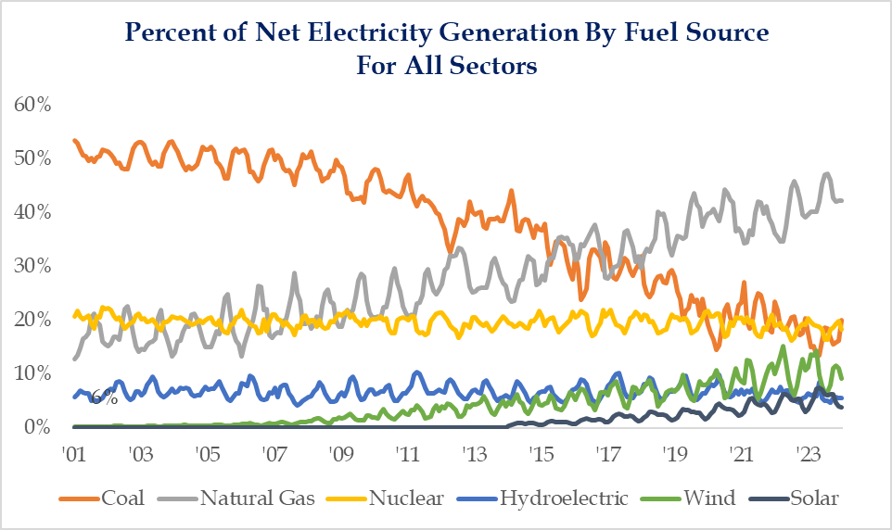
With “AI” Comes The Need For Additional Power Generation
While all of the focus these days tends to be on the renewable portions of energy sources, the reality is that natural gas and coal account for about 2/3 of net electricity generation in the United States. The recent craze of “AI” has pulled to the forefront the need for additional power generation, and it appears focus is shifting away from solely renewables. Earlier this year, NJ was looking to extend the life of 3 power plants another 20 years and just yesterday Energy Secretary Jennifer Granholm acknowledged the U.S. may revive shut nuclear plants. Perhaps the bigger takeaway from all of this for all the talk of ending “dirty” forms of energy, the ability to do so is going to take much longer than many of the set-out goals.
Strategas Securities – Investment Strategy

Slide 43
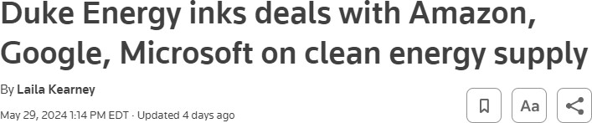
5) WITH OR WITHOUT “AI” AN INDUSTRIAL POWER
RENAISSANCE IS LIKELY IN THE EARLY STAGES
Global Trends in Digital and Energy Indicators, 2015-2022
 | 2015 | 2022 | Change
Internet users | 3 billion | 5.3 billion | +78%
Internet traffic | 0.6 ZB | 4.4 ZB | +600%
Data centre workloads | 180 million | 800 million | +340%
Data centre energy use (excluding crypto) | 200 TWh | 240-340 TWh | +20-70%
Crypto mining energy use | 4 TWh | 100-150 TWh | +2300-3500%
Data transmission network energy use | 220 TWh | 260-360 TWh | +18-64%
Source: IEA
Global Electricity Consumption
From Data Centres (TWh)
1200
1000
1000
117%
800
600
460
400
200
0
2022
Source: IEA 2024 Annual Electricity Analysis & Forecast, TWh: Terawatt-hour
2026
Strategas Securities – Investment Strategy

Slide 44
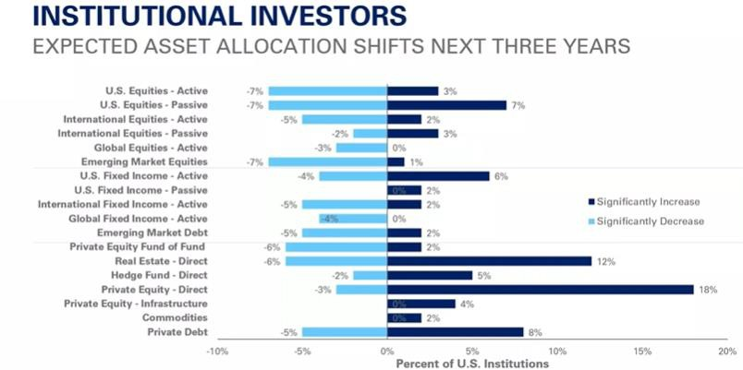
DEMAND FOR PRIVATE EQUITY CONTINUES TO GROW
Source: Greenwich Associates, 2022
Strategas Securities – Investment Strategy

Slide 45
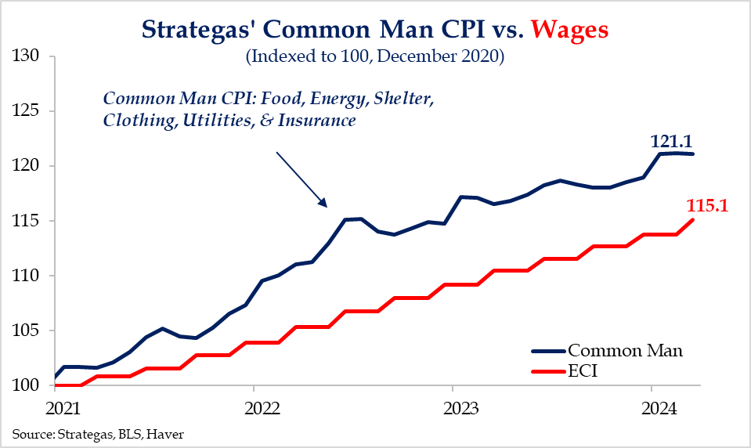
1) WASHINGTON TO TAKE A NO HOLDS BARRED APPROACH TO STIMULATE IN AN ELECTION YEAR…
Strategic Petroleum Reserve – lowest level since 1983
Treasury General Account – war chest to use ahead of election
Treasury Issuance - more bills, fewer bonds; LT interest stays low
ON Reverse Repo – helps offset QT, helps keep rates low
Student Loan Forgiveness - $167 billion in Biden Admin.
More Employee Retention Tax Credit – stimulus to start again
…WITHOUT CONSIDERING THE CONSEQUENCES
Strategas Securities – Investment Strategy

Slide 46
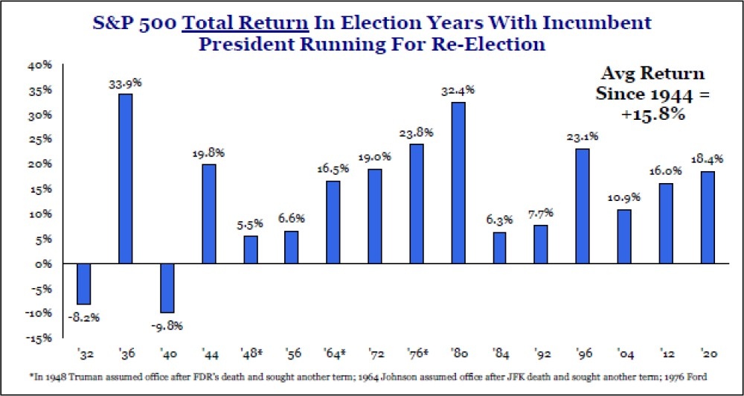
THE S&P 500 HAS INCREASED IN THE PAST 13 PRESIDENTIAL RE-ELECTION YEARS
Strategas Securities – Investment Strategy

